Slide 1
Welcome to today’s service!

Slide 2
Blackburn Baptist Church Notices for This Week

Slide 3
We’ve received a request from Griffin Park Primary School for some of their pupils to visit the chapel in the near future
Would you be willing to be here to help?
There will be a short meeting after today’s service for those who can support this

Slide 4
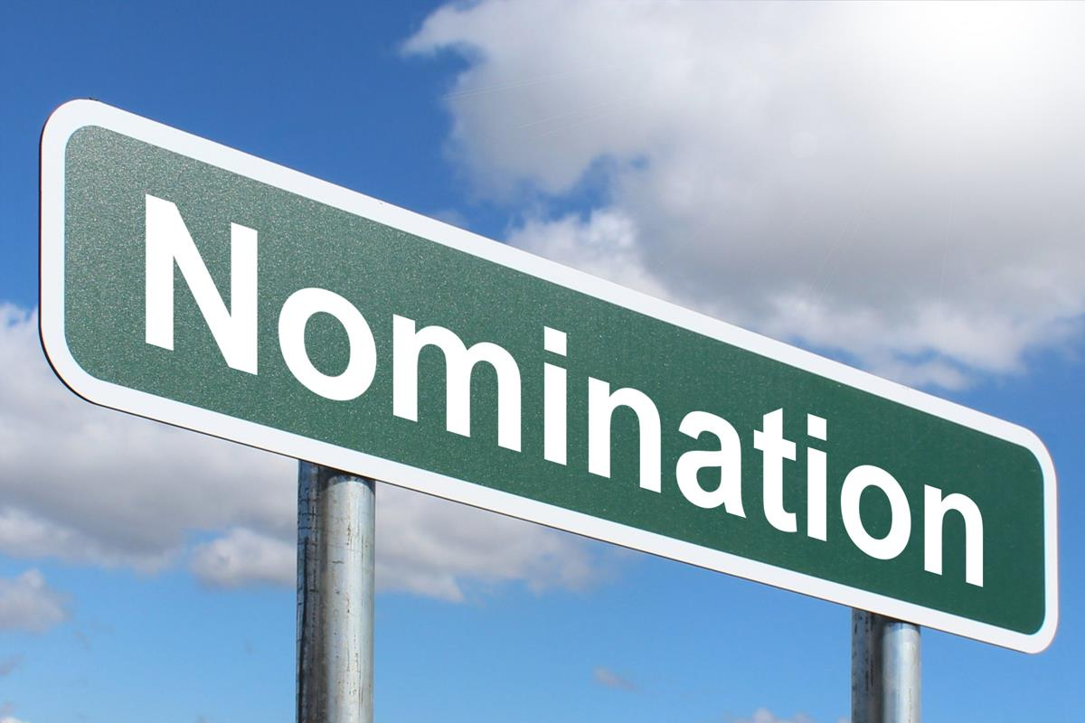
Nominations for the diaconate for the election of deacons due in November need to be received by Sunday 30 October
A nomination form is available from Jane Farmer
That’s today!

Slide 5
Bright Party!
Calling all kids!
We’re having a party here tomorrow evening (31 October) at 6 pm to celebrate the light of Jesus - rather than the darkness of Halloween. Why not come along?

Slide 6
Please help if you can with our self-help cleaning on Thursday 3 November, 10.00 – 11.30

Slide 7
Regular Activities During the Coming Week
‘Take a Break’ Coffee Morning | Tuesday 1, 10.00 – 12.30
Informal Music Morning | Tuesday 1, 10.30
Ladies’ Bible Study | Tuesday 1, 10.45
‘Tiddlywinks’ Parent and Toddler Group | Wednesday 2, 09.30 – 11.30
‘Orbit’ Youth Drop-in (two age-based groups) | Thursday 3, 16.45 – 19.30
Fellowship Meeting (Prayer Meeting) | Thursday 3, 19.30 – 20.30
New Life International Church: Bible Study & Prayer | Friday 4, 20.00
Movie Morning | Saturday 5, 10.30 – 12.00
New Life International Church: Service | Saturday 5, 17.00

Slide 8
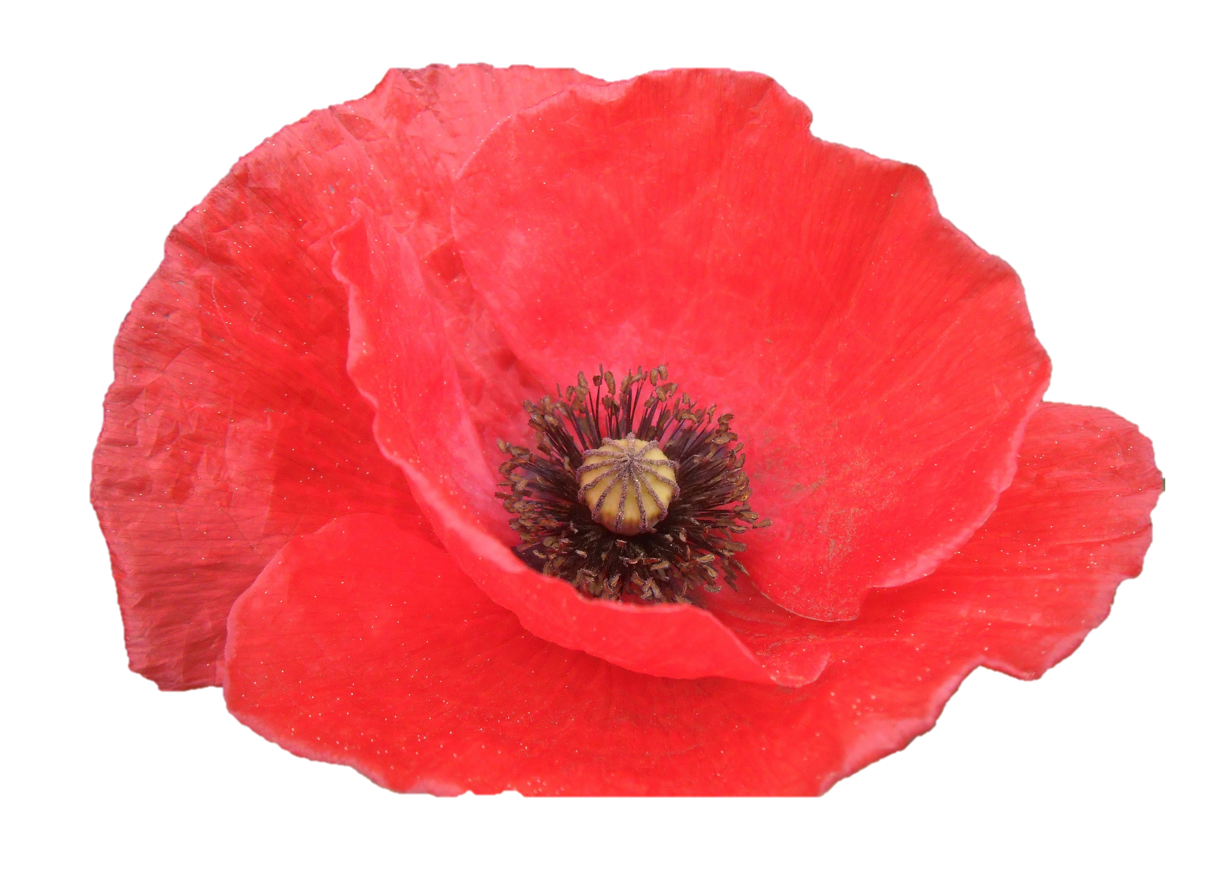
Next Sunday, 6 November
10.45 am at Bethesda Chapel
Communion service
Sunday, 13 November
Remembrance Day service, led by Alec

Slide 9
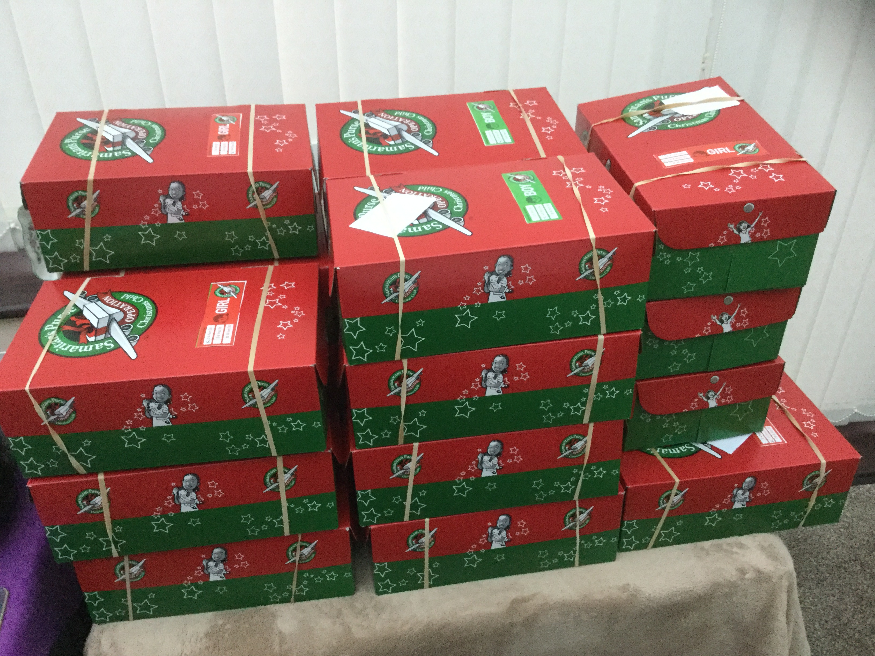
We’re planning to support Operation Christmas Child again this year – packing shoeboxes for children who will have very little this Christmas
If you can get involved, we have some leaflets with instructions and boxes available here – or contact Morag Dewhurst for more information
The last Sunday that boxes can be returned is 20 November

